Slide 1
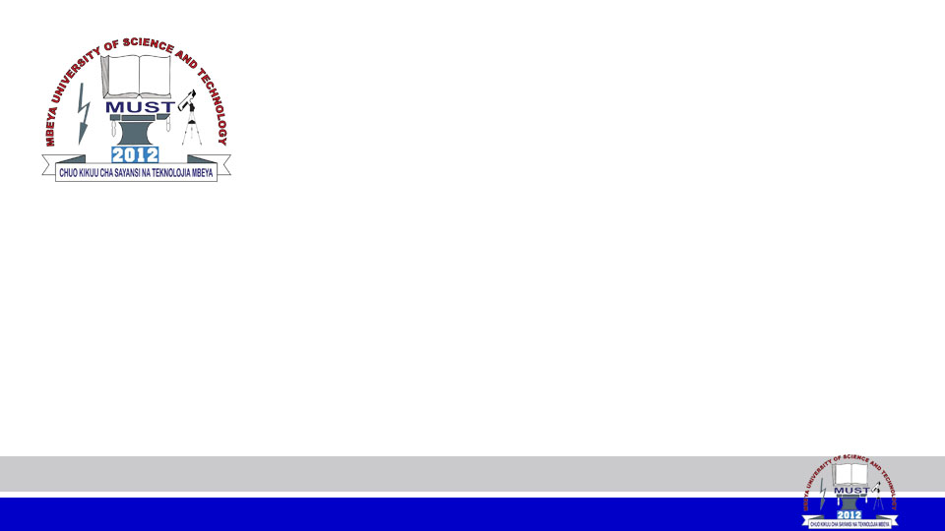
MEMORY MANAGEMENT
MODULE CODE: CS 6146
MODULE NAME: Operating Systems
FACILITATOR: Pangahela, R. A
Email: pangriz@gmail.com Phone: +255 742 926 569

Slide 2
Agenda
  Background
  Main Memory
  Cache Memory
  Address Binding
  Memory Management Approaches
    Single Contiguous Model
    Partition with Contiguous Allocation
    Swapping
    Segmentation
    Paging
  Virtual Memory Basics
  Optimizing Applications Performance

Slide 3
Background
The second most important hardware resource in the computer system after the CPU is the Memory.
Memory accesses and memory management are a very important part of modern computer operation. Every instruction has to be fetched from memory before it can be executed, and most instructions involve retrieving data from memory or storing data in memory or both.

Slide 4
The introduction of multi-tasking OSes increases the need for complex memory management, because as processes are swapped in and out of the CPU, so must their code and data be swapped in and out of memory, all at high speeds and without interfering with any other processes.

Slide 5
What is Main Memory
Main Memory or (Random Access Memory - RAM): is the area in a computer in which data is stored for quick access by the computer's processor.
RAM speed is measured in nanoseconds (billionths of a second), while magnetic and SSD storage is measured in milliseconds (thousandths of a second).
Program must be brought (from disk) into memory and placed within a process for it to be run
Main memory and registers are only storage CPU can access directly

Slide 6
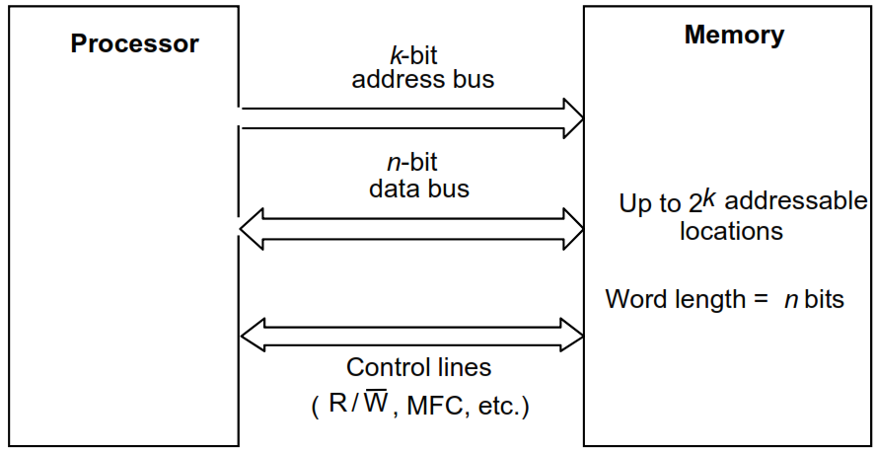
CPU-Main Memory Connection

Slide 7
Cache Memory
Cache Memory: is a small-sized type of volatile computer memory that provides high-speed data access to a processor and stores frequently used computer code and data.
It is the fastest memory in a computer, and is typically integrated onto the motherboard and/or directly embedded in the processor.

Slide 8
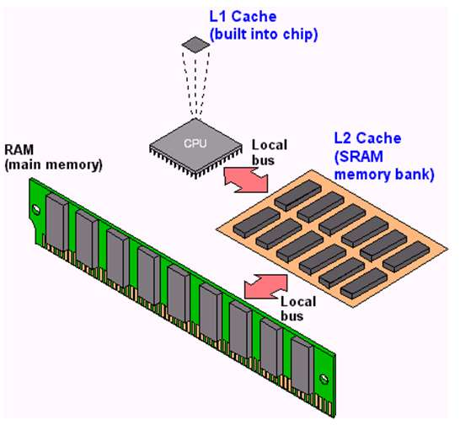

Slide 9
Libraries Linking
Static linking – It is the case when system libraries and program code are combined by the loader into the binary program image.
Dynamic linking – It is the case when linking of the routines to the main program is postponed until execution time.
Stub is a small piece of code, used to locate the appropriate memory-resident library routine and replaces itself with the address of the routine, and executes the routine

Slide 10
Advantages of Dynamic Linking and Shared Libraries:
  Less program loading time
  Less memory space
  Less disk space to store binaries

Slide 11
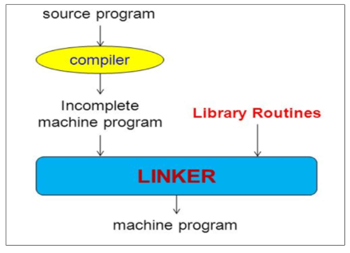
Static Linking Diagram

Slide 12
Address Binding Schemes
Address binding of instructions and data to memory addresses can happen at three different schemes:
  Compile time binding: when the absolute code will be generated by the compiler, containing actual physical addresses (like in MSDOS .com programs).
  Load time binding: the compiler must generate relocatable code, which references addresses relative to the start of the program.

Slide 13
  Execution time binding: is when binding must be delayed until execution time, so the program can be moved around in memory during execution. This is the method which is implemented by most modern OSes.

Slide 14
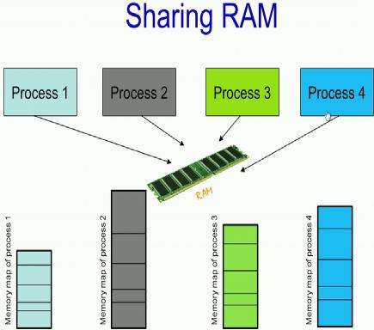
Memory Management Approaches
Memory Management is allocating, freeing, and reorganizing memory in a computer system to optimize the available memory or to make more memory available. It keeps track of every memory location(if it is free or occupied).
Historically, the below memory management approaches have been used
  Single Contiguous Model
  Partition with Contiguous Allocation
  Swapping
  Segmentation
  Paging

Slide 15
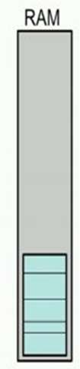
1. Single Contiguous Model
Is one of the most primitive ways of managing memory especially done for the older on a operating systems.
So RAM is occupied by one process at a time. Essentially at any particular instant there is only one process and its memory size is restricted by the RAM size.
After this process completes executing, the next process will be loaded into the RAM (no sharing).
Process memory size is restricted by RAM size.

Slide 16
2. Partition with Contiguous Allocation
In this approach at any instant of time, we could have multiple processes that occupy the RAM simultaneously but each process should be contained in a single contiguous partition of memory.
As long sufficient contiguous space is available, new processes are allocated memory. When a process completes execution, the area in RAM that it holds will be de-allocated. Consequently the entry corresponding to the partition table will be free.

Slide 17
This approach is a slight improvement over the single contiguous model.
Main memory is usually partitioned into two parts:
  Resident operating system area.
  User processes area.
The Partition Table would have the base address of a process, the size of the process and a process identifier.

Slide 18
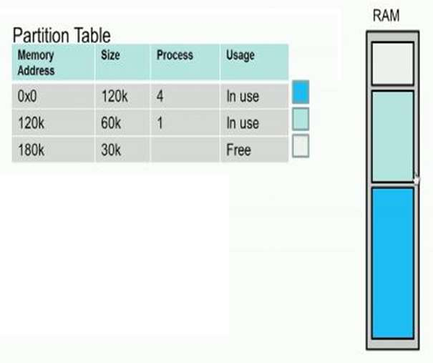
Diagram of Partition with Contiguous Allocation

Slide 19
Limitations of
Partition with Contiguous Allocation
Each Process needs to be entirely in RAM.
Allocation needs to be in contiguous memory
External Fragmentation
Limit the size of the process by RAM size
Performance Degradation

Slide 20
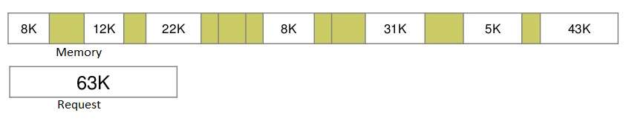
External Fragmentation
External Fragmentation – It is the case when total memory space exists to satisfy a request, but it is not contiguous. This is a problem with Partition with Contiguous Allocation memory management approach.

Slide 21
Compaction
Compaction: is shuffling memory contents to place all free memory together in one large block
Compaction is a solution to Reduce external fragmentation.
  Compaction is possible only if relocation is dynamic, and is done at execution time

Slide 22
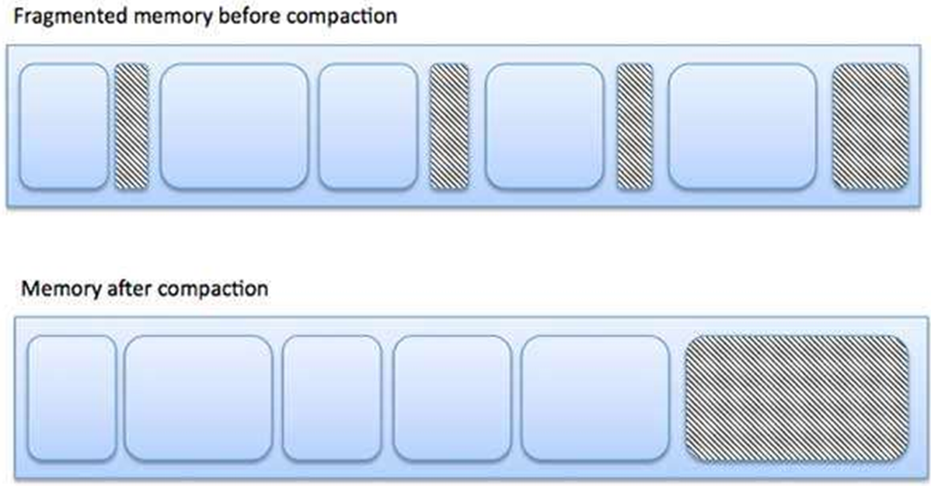

Slide 23
3. Swapping
Swapping is a technique in which a process can be moved temporarily out of memory to Backing Store (HD or SSD), and then brought back into memory for continued execution.
Backing store – is a fast disk large enough to accommodate copies of all memory images for all processes; and must provide direct access to these memory images.

Slide 24
The swapping procedures that are found on modern operating systems (i.e., UNIX, Linux, and Windows) are:
  Swapping is normally disabled
  Swapping will be started if memory demand is more than certain threshold amount of memory.
  Swapping will be disabled again once memory demand is reduced below certain threshold.

Slide 25


Slide 26
4. Segmentation
Segmentation: is a memory-management approach that is implemented by segmenting processes and loading them into different non-contiguous addressed spaces in memory with different segment address.
In Segmentation we have a Segment Descriptor Table which is stored in memory. Each row in the segment descriptor table refers to one particular segment. For instance, the Data segment 2 is at an offset 2 in the Segment descriptor table, and the offset would specify the Base address in RAM and the Limit of the segment.

Slide 27
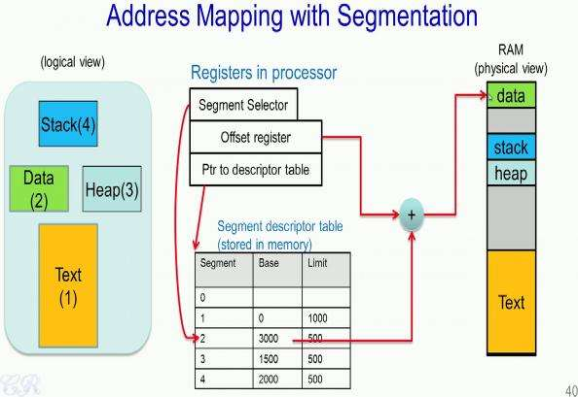

Slide 28
5. Paging
Paging is to divide physical memory into fixed-sized blocks called frames and divide logical memory into blocks of same size called pages
Physical address space of a process can be noncontiguous.
Paging eliminates external fragmentation , but it still suffers from Internal fragmentation.
Page Size is a power of 2, usually between 512 bytes and 16 Mbytes
To load a process of size S where (N-1) pages < S < (N) pages, it is required to find N free frames to load the process.

Slide 29
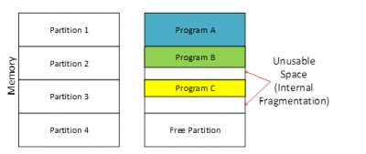
Internal Fragmentation
Internal Fragmentation – is this size difference in memory that happens when we divide memory to fixed partitions and then allocated memory may be slightly larger than requested memory.

Slide 30
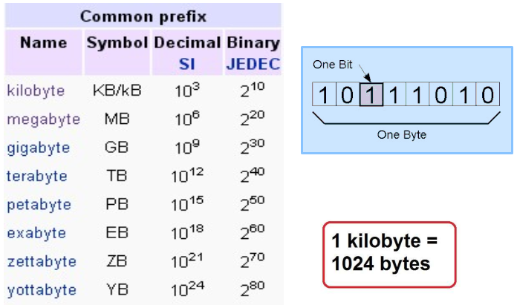
What is Kilobyte?

Slide 31
Page Table
The page table is the table used to look up what frame a particular page is stored in at the moment. It translates logical to physical addresses.
Associative Memory is a special fast-lookup hardware cache that can solve the two memory access problem if page table is stored in main memory.

Slide 32
Q\ Why Page size selection is critical?
  A large page will result in increase of internal fragmentation
  A small page size will increase the size of the page table
The Page Table Structure can be of two types:
  Basic Paging: A single page table which stores the page number and the offset
  Hierarchical Paging: A multi-level table which breaks up the virtual address into multiple page tables.

Slide 33
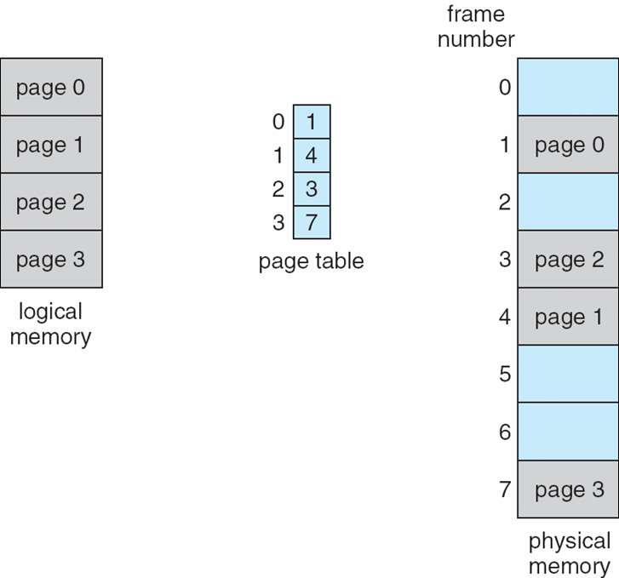
Basic Paging Diagram

Slide 34
Shared Pages
Shared code
  One copy of read-only code can be shared among processes (i.e., text editors, compilers, window systems)
  It is also useful for inter-process communication if sharing of read-write pages is allowed
Private code and data
  Each process keeps a separate copy of the code and data
  The pages for the private code and data can appear anywhere in the logical address space

Slide 35
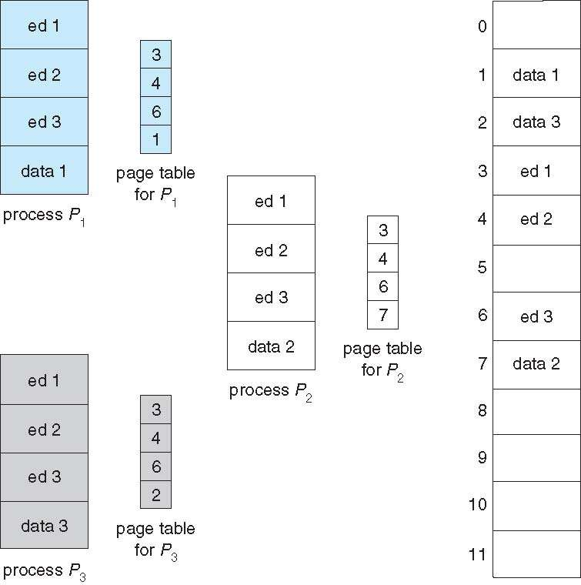
Shared Pages Diagram

Slide 36
Virtual Memory Basics
Virtual Memory increases the available memory of the computer by enlarging the "address space," or places in memory where data can be stored. It does this by using hard disk space for additional memory allocation.
However, since the hard drive is much slower than the RAM, data stored in virtual memory must be mapped back to real memory in order to be used.

Slide 37
Q\ Why most real processes do not need all their pages?
  Error handling code is not needed unless that error occur.
  Only a small fraction of the arrays are actually used.
  Certain routines of programs are rarely used.

Slide 38
Logical vs. Physical Address Space
The concept of a logical address space that is bound to a separate physical address space is central to virtual memory
Logical address (virtual address) – it is the address generated by the process executing currently on the CPU.
Physical address – it is the address seen by the memory management unit where actual code and data are loaded.
The user process deals with logical addresses; it never sees the real physical addresses
Memory-Management Unit: is the Hardware device that at run time maps virtual to physical address.

Slide 39
Benefits of Virtual Memory
In virtual memory, Logical address space can therefore be much larger than physical address space
Every process executing in the system would have its own process page table.
Benefits of Virtual Memory are:
  Only part of the program needs to be in memory for execution
  Allows address spaces to be shared by several processes

Slide 40
  More programs can run concurrently
Page Fault: is a type of trap raised when a running process accesses a memory page that is not currently in the physical RAM
Page replacement is finding some page in memory, which is not really in use, in order to page it out.

Slide 41
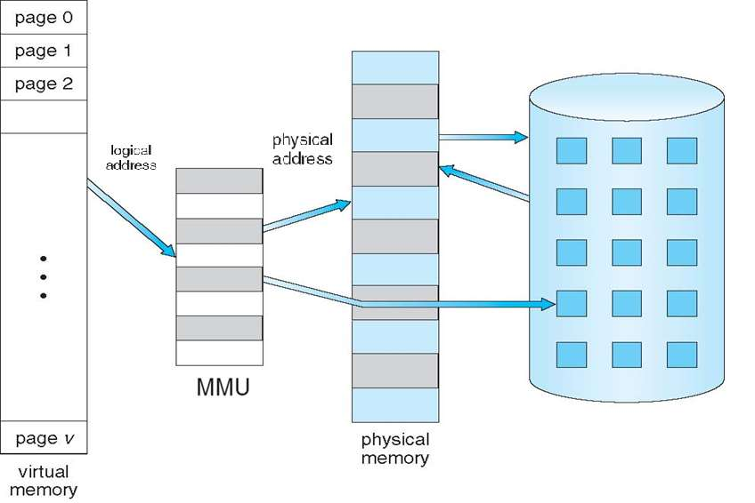
The General Layout of Virtual Memory

Slide 42
Thrashing and Memory Leaks
Thrashing: it is the case when a process does not have “enough” pages, then page-fault rate will become very high and the process will be busy swapping pages in and out
Memory Leak: occurs when an application is using more RAM than it normally does which in turn slows down the system, causing it to struggle with performing even the basic tasks.

Slide 43
Optimizing Applications Performance
Optimizing Applications depends heavily on memory organization in the computer system. The next few points offer some pointers for improving the performance of applications under Windows :
  Adding More Physical Memory
  Defragment the Hard Drive containing the paging file
  Installing Applications to the Fastest Hard Drive
  Getting the Latest Device Drivers
  Move Extra workload to Another Server

Slide 44
1. Adding More Physical Memory
All applications run in RAM, of course, so the more RAM you have, the less likely it is that Windows will have to store excess program or document data in the page file on the hard disk, which is a real performance killer.
Use one of the following Windows monitoring tools to watch the available memory:
Task Manager —Display the Performance tab and watch the Physical Memory: Available value.

Slide 45
Resource Monitor —Display the Memory tab and watch the Available to Programs value. .
Performance Monitor —Start a new counter, open the Memory category, and then select the Available Mbytes counter.

Slide 46
2. Defragment the Hard Drive containing the Paging File
This is needed when the page file is located on a disk that is heavily used by other applications.
Hard Disk Defragmentation is to organize the files parts in contiguous sectors on the disk, thereby improving computer performance and maximizing disk space.
The solution steps are:
  move the page file to another drive temporarily.

Slide 47
  set the paging file on the original drive to be fragmented to 0 MB.
  reboot the system to enable the other paging file to be used.
  perform the disk defragmentation on the original drive.
  set the paging file on the original drive to the necessary values, and reboot.

Slide 48
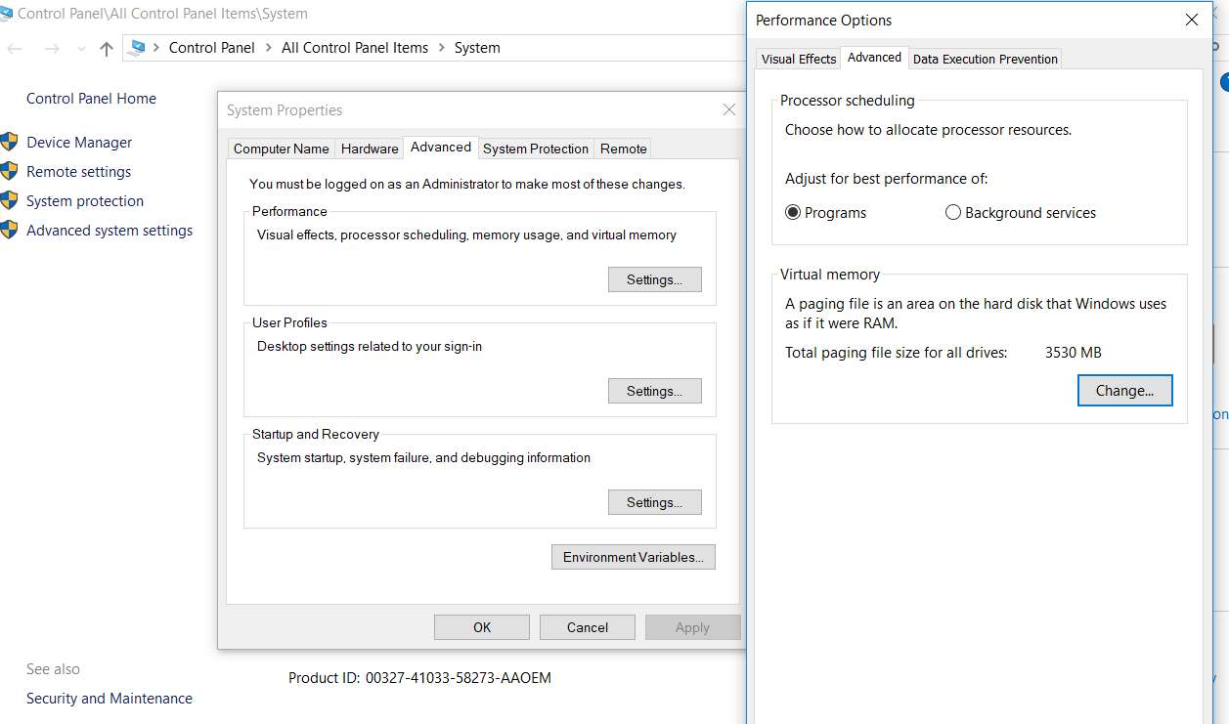
Paging file in Windows 10

Slide 49
3. Installing Applications to the Fastest Hard Drive
If your system has multiple hard drives that have different performance ratings, install your applications on the fastest drive. This enables Windows to access the application’s data and documents faster.
4. Getting the Latest Disk Drivers
If your application works with a device, check with the manufacturer or Windows Update to see

Slide 50
whether a newer version of the device driver is available. In general, the newer the driver, the faster its performance.
5. Move Extra workload to Another Server
For Server Machine, you may also elect to offload some of the workload to another system.

Slide 51
END
THANK YOU

